Slide 1
ethylene oligomerization: molecular strategies to avoid polyethylene fouling
Sibo Lin*, YagnaSENI Ghosh, DANA A. WONG, DOUGLAS THEBERGE, BRIAN HANNA
Aramco services company: Aramco Research Center -- Boston

Slide 2
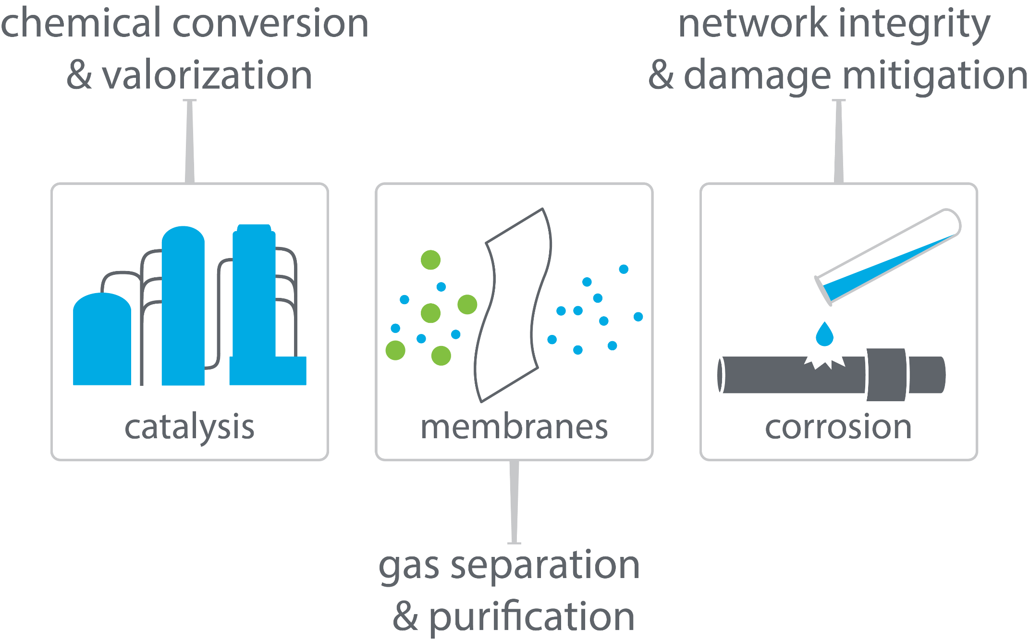
boston downstream research center

Slide 3
boston downstream research center

Slide 4

linear α-olefins for LLDPE
polyethylene plant
LLDPE
1-butene
ethylene
1-hexene
1-butene
1-hexene
polymer quality increases
1-octene
1-octene
highest quality plastic

Slide 5

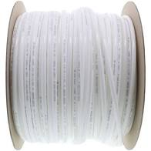
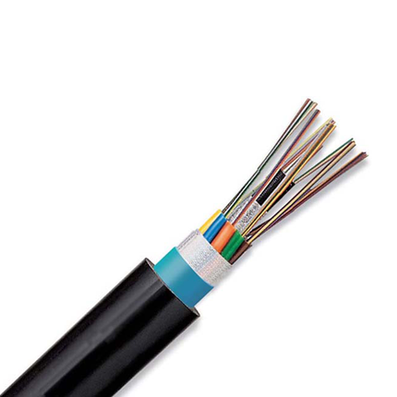

LLDPE
tough
flexible and food-safe
1-butene
stretchable
electrical and chemical safety
1-hexene
1-octene
Notes:
Image credits:
https://www.uline.com/Product/Detail/S-12827/Uline-Stretch-Wrap/Economy-Stretch-Wrap-Cast-80-gauge-18-x-1500
https://www.freshwatersystems.com/products/3-8-od-lldpe-polyethylene-tubing-500-ft-roll
https://www.hillnmarkes.com/
http://www.blspolymers.com/LLDPE.htm

Slide 6
full range α-olefins processes
How to make 1-octene selectively?
undesired products
1-butene
1-hexene
existing commercialized full range technologies:
Shell Higher Olefin Process (SHOP)
Chevron Phillips full-range process
INEOS process
1-octene
Nexant report - Developments in LAO Comonomer for Polyethylene - PERP 2012S11

Slide 7

two strategies for more 1-octene
confining full-range catalysts
selective ethylene tetramerization
modify a full-range catalyst to skew the product distribution
Nexant report - Developments in LAO Comonomer for Polyethylene - PERP 2012S11

Slide 8
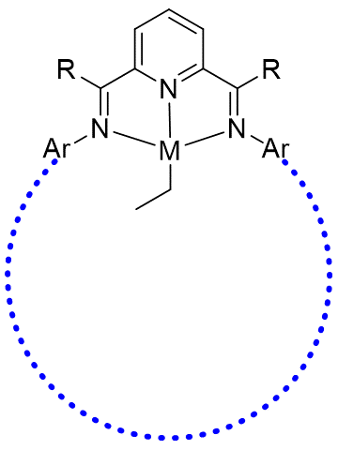
confining full-range catalysts
pyridyl diimine (PDI) catalysts
highly active
Schulz-Flory product distribution
troublesome polymer byproduct
confine full-range catalyst to cut off larger product distribution
Small, B. L. Acc. Chem. Res. 2015, 48, 2599
proposed confinement
chain-pore steric interactions

Slide 9


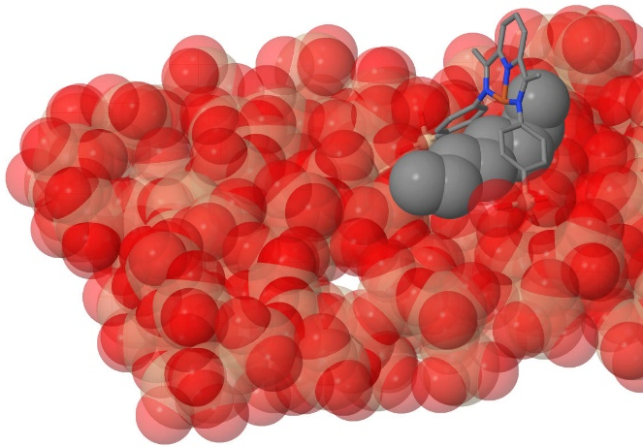
pore construction strategies
material | pore dimensions | pore size tunability | synthetic feasibility | synthetic tunability | reactant accessibility
zeolite
MOF
molecular
surface pores

Slide 10
Greatly Reduced PE via Surface Confined Catalysts
A
B
A’
B’
Conditions: 0.8 umol Cr or Fe; 500:1 Al(MMAO-3A)/Cr; MeCy solvent; 1h at 45 ºC
“Surface supported catalysts with pore size control” SA6751 filed non-provisionally 08/18/21
Notes:
PDI catalyst reference: Small, B. L. Acc. Chem. Res. 2015, 48, 2599
Catalytic Conditions: 0.8 umol Cr or Fe; 500:1 Al(MMAO-3A)/Cr-or-Ti; MeCy solvent; 1h at 45 ºC

Slide 11
Ethylene Tetramerization Challenges
polyethylene byproduct fouling can cause reactor unit downtime
Bollman et al, J. Am. Chem. Soc. 2004, 126, 14712
Blann et al, J. Catal. 2007, 249, 244.
Target
Molecular design of novel catalysts that:
Increase activity
Increase 1-octene selectivity
Decrease PE wt%
Notes:
Benchmark References)

Slide 12
ligand degradation may result in polyethylene
ligand | acid adduct¹ | activity² | C8 (wt%) | C6 (wt%) | PE (wt%)
 |  | 85 | 43 | 24 | 31
 |  | 1700 | 54 | 38 | 3
¹ Product with H[BAr^{F}₄]
² Catalytic activity (g/g Cr/h) with CrCl₃(THF)₃, 300 equiv. MMAO-3A, 60 psi C₂H₄
Agapie and coworkers, Organometallics, 2017, 36, 1640

Slide 13
hypotheses
computational modelling can predict PNP ligand stability
PNP instability is correlated with PE formation

Slide 14
computational prediction of isomerization thermochemistry (ΔG_{PPN})
2
2
3
2
3
2
3
wrong ΔG
how many conformers?
right ΔG
ca. 3³ x 2⁴ = 432
too many to rely on human intuition or employ brute-force high-level simulations

Slide 15
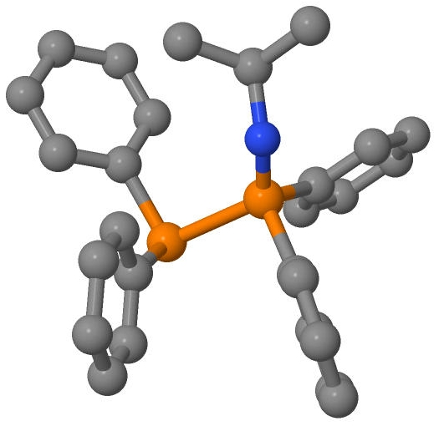
XTBDFT
conformer ensemble generation and ranking
(CREST and GFN-xTB)
ensemble refinement (NWChem)
minimum final optimization (NWChem)
quasi-harmonic frequency corrections
(Goodvibes)
62 conformers within 6 kcal/mol window
final structure and energy*
input geometry
(PES is only illustrative)
*calculated with B3LYP-D3/def2-TZVP//B3LYP-D3/def2-SVP and quasi-harmonic frequency corrections

Slide 16
ΔG_{PPN} vs known PNP/PPN ligands
ΔG_{PPN} > 0 (PNP favored)
ΔG_{PPN} < 0 (PPN favored)
If |ΔG_{PPN}| > 0.9 kcal/mol, prediction matches observations for 30+ known PNP/PPN

Slide 17
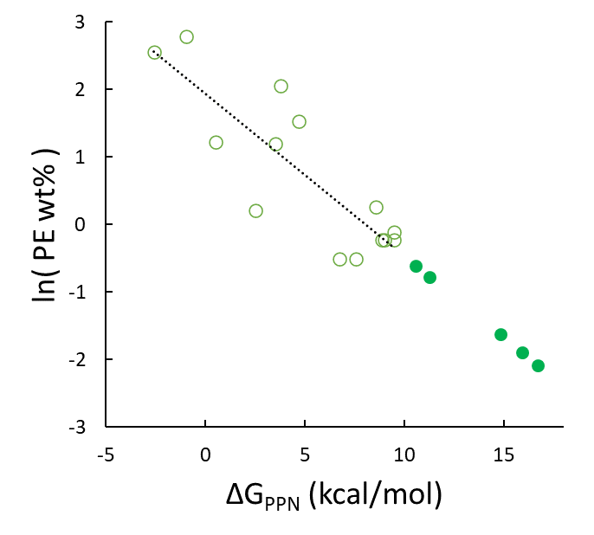
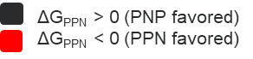
Ligand Stability Correlates with Lower PE wt%
unstable ligand candidates screened out
projected
activities
extra-stable ligands being tested and synthesized now
Lin, S.; Fromer, J. C.; Ghosh, Y.; Hanna, B.; Elanany, M.; Xu, W. Sci. Rep. 2021, 11, 4534.

Slide 18
design criteria to maximize PNP stability (and lower PE fouling)
electron-rich N-substituents
N-alkyl over N-aryl
R | ΔG_{PPN}
OMe | 4.7
H | 3.5
NO₂ | -0.9
ΔG_{PPN} | 3.5 | 9.0 | 0.5 | 8.9
N-alkyl: 2˚ > 1˚ >> 3˚
electron-poor P-substituents
R | ΔG_{PPN}
CH₂Ph | 8.6
CHMe₂ | 9.5
CMe₃ | 2.5
R | ΔG_{PPN}
CF₃ | 11.6
H | 9.5
OMe | -0.1
ΔG_{PPN} in kcal/mol

Slide 19
optimized PNP ligands compared with benchmark catalyst
ligand | Productivity | Product selectivity (wt%)
 | (kg g_{Cr}⁻¹ h⁻¹) | C₆ | 1-C₆ (in C₆) | C₈ | 1-C₈ (in C₈) | 1-C₆ + 1-C₈ | C₁₀₊ | PE
benchmark | 1184 | 22.8 | 81.6 | 72 | 97.1 | 88.5 | 1.6 | 3.5
ligand 1 | 1717 | 40.9 | 95.3 | 57.5 | 98.2 | 95.4 | 0.1 | 1.5
ligand 2 | 1492 | 24.1 | 56.1 | 72.5 | 95.2 | 82.5 | 2.6 | 0.8
ligands studied in collaboration with Samir Barman and E. A. Jaseer (KFUPM), manuscript in preparation

Slide 20
selective ethylene tetramerization summary
supported hypotheses
http://github.com/sibo/xtbdft
ruled out several candidates
developed novel PNP ligands
45% higher productivity
7.8% higher 1-C6 + 1-C8 wt%
57% lower PE wt%
Sci. Rep. 2021, 11, 4534

Slide 21
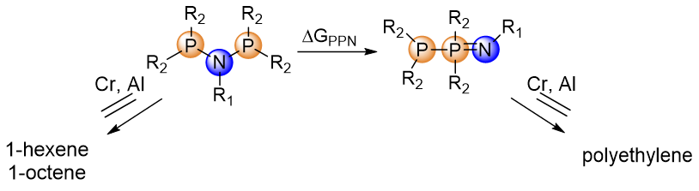
acknowledgements
Aramco Americas
Advanced Materials Team (Cambridge, MA)
Jenna C. Fromer
Yagnaseni Ghosh
Brian Hanna
Douglas Theberge
Dana A. Wong
Saudi Aramco Chemicals R&D
Wei Xu
Mohamed Elanany
Motaz Khawaji
King Fahd Univ. of Petroleum and Minerals
E. A. Jaseer
Samir Barman

Slide 22
supplementary slides…

Slide 23
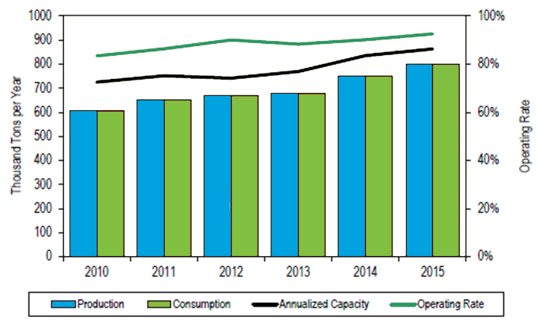
need for selective ethylene tetramerization
production capacity of 1-octene is not projected to keep pace with demand
1-butene
1-hexene
1-octene
Nexant report - Developments in LAO Comonomer for Polyethylene - PERP 2012S11
Confidential

Slide 24
Inverse logarithmic relation
As a simplified model, if :
PNP and PPN isomers are in thermodynamic equilibrium ([PPN]₀/[PNP]₀ = e^{−ΔGPPN/RT})
initial PNP concentration is directly correlated with ethylene oligomerization productivity (oligomerization productivity = a[PNP]₀)
initial PPN concentration is directly correlated with polymerization productivity (polymerization productivity = b[PPN]₀)
a and b are constant across the range of PNP and PPN compounds
Then the following relation should be observed:
ln(polyethylene wt%)=ln(b/a)−ΔGPPN / RT
S. Kuhlmann, K. Blann, et al., J. Catal., 2007, 245, 279-284
K. Blann, A. Bollmann, et al., J. Catal., 2007, 249, 244-249.
E. Killian, K. Blann, et al., J. Mol. Catal. A: Chem., 2007, 270, 214-218.

Slide 25
GFN-xTB/CREST vs molecular mechanics (MM)
Computational intensity: MM < GFN-xTB << DFT
MM methods must be carefully parameterized for molecules of interest
Commonly available MM methods (MMFF and UFF) perform poorly with metal centers or exotic functional groups
GFN-xTB is generally applicable to many elements (H-Rn) and types of molecules[ref]
CREST uses meta-dynamics to explore wide conformer space
CREST also eliminates symmetrically equivalent conformers (by comparing energy and symmetry)

Slide 26
1-octene results from metallocycle mechanism
Metallocycle formation
Ring growth
Ring termination (β-hydride transfer)

Slide 27
McGuinness’s 2016 DFT mechanism study
Model of truncated ligand predicts (too) high 1-octene/1-hexene ratio (ΔΔG = 5.7 kcal/mol)
7 conformers of 18b were considered
1 conformer of TS18f-19 was considered
Many more were not explicitly modelled
Replacing N-Me with N-iPr: ~3x # of conformers

Slide 28

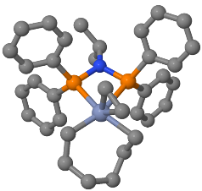
Computational: Automated Conformational Analysis (XTBDFT)
autoConf
Automated multi-level conformational search
Built on 3 open-source engines:
GFN-xTB/CREST
NWChem
GoodVibes
Simplified user input
Lightweight (for facile installation on internet-restricted compute clusters)
input geometry
(and charge and spin)
final structure and energy
XTBDFT
single-ended reaction coordinate scan
(GFN-xTB)
conformer ensemble generation & ranking
(CREST and GFN-xTB)
ensemble refinement (NWChem)
minimum final optimization (NWChem)
quasi-harmonic frequency corrections
(Goodvibes)
input reactant geometry
specify reaction coordinate
(and charge and spin)
final TS structure and energy
autoTS
Lin, S. SoftwareX 2021, in preparation

Slide 29
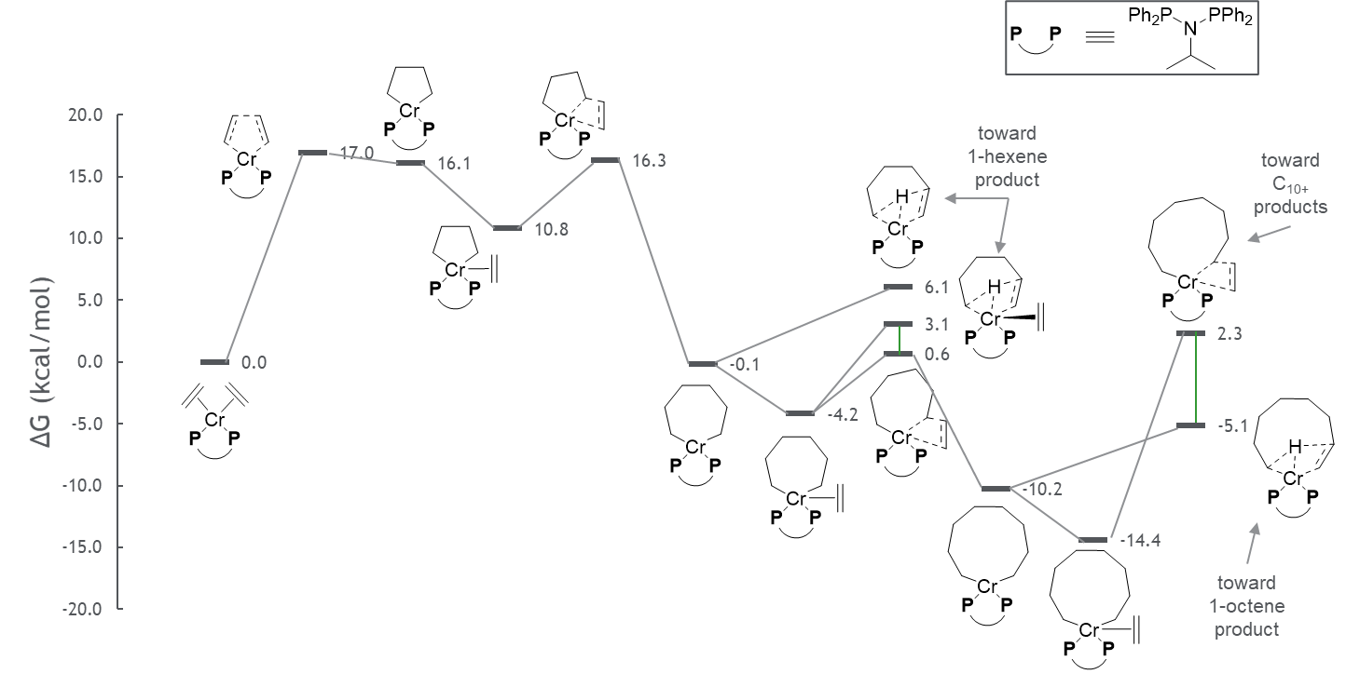
Computational: First Detailed Reaction Mechanism of Full Sasol Ligand
D. Technical Review
correct prediction of 1-octene/1-hexene ratio
turnover-limiting barriers
product-determining barriers
Lin, S.; Elanany, M.; Khawaji, M.; Xu, W. ACS Catal. 2021, in preparation

Slide 30
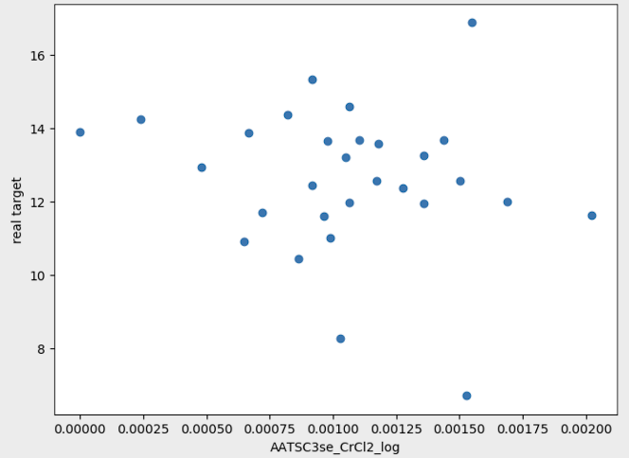
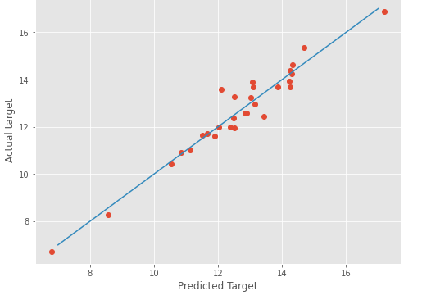
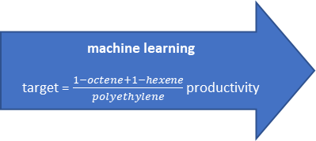
Computational: Machine Learning Models
D. Technical Review
machine learning
target = $\frac{1−octene+1−hexene}{polyethylene}$ productivity
Input
Catalytic data (literature)
Catalyst 3D structural descriptors
Quantum chemical descriptors
SambVca descriptors
Mordred descriptors
Data Modelling
by Worcester Polytechnic Institute
Data transformations and imputations
Stepwise regression model
Autocorrelation of Topological Structure (ATS) descriptors from Mordred are particularly useful
representative single-descriptor model
(2000+ descriptors)
composite 11-descriptor model
(R² = 0.94)
unpacking the predictive power of ML model

